Slide 1

DAT368 – Python Wrangling for SAP HANA Application Developers
Notes:
Hello and welcome to workshop session DAT368, Python Wrangling for SAP HANA Application Developers. I'm <speaker name> and I work as a <title> for the ISV A-Team. As such, I often have occasion to work with partners who are moving an existing solution to SAP HANA or are developing new solutions using HANA and other SAP technologies. Today's workshop will focus on using the python development language in HANA XS Advanced micro service application development. Since XS Advanced is descended from the general cloud foundry approach to micro services, you'll find the most things we cover today will also apply when deploying to cloud environments as well. In fact we'll strive to follow best practices that will enable us to deploy applications with python based components as flexibly as possible. If there are details that apply specifically to on-premise or cloud environments, I'll attempt to point them out as we go along.

Slide 2

Speakers 2018
SAP TechEd Las Vegas October 2–5, 2018 | Andrew Lunde Harini Gunabalan
SAP TechEd Barcelona October 23–25, 2018 | Aron MacDonald Harini Gunabalan
SAP TechEd Bangalore November 28–30, 2018 | Abhijeet G Chinchanikar Arun Srinivasan
Notes:
Again my name is <speaker name> and today I’m joined by <assistant name> who will also be helping facilitate today’s workshop.

Slide 3
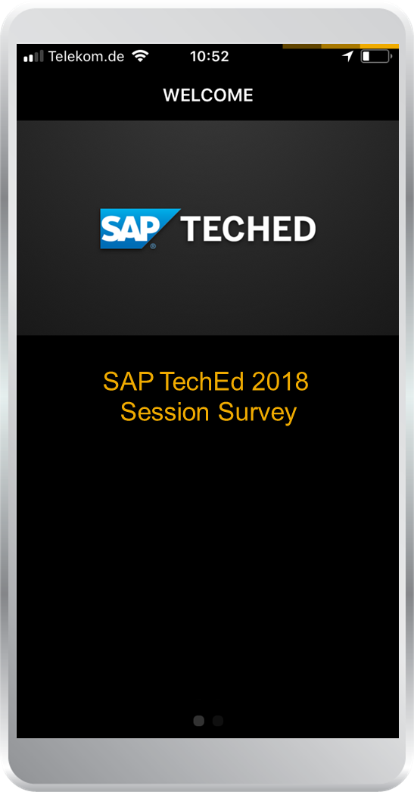
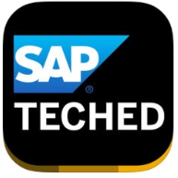
Take the session survey.
We want to hear from you! Be sure to complete the session evaluation on the SAP TechEd mobile app.
Download the app from iPhone App Store or Google Play.
Notes:
I know it’s a pain and everyone is anxious to get to the next session, but I do ask that you please fill out the survey for this workshop as your comments truly do help us improve the workshop content in the future.
<Remind participants now and at the end of the workshop.>

Slide 4
Disclaimer
The information in this presentation is confidential and proprietary to SAP and may not be disclosed without the permission of SAP. Except for your obligation to protect confidential information, this presentation is not subject to your license agreement or any other service or subscription agreement with SAP. SAP has no obligation to pursue any course of business outlined in this presentation or any related document, or to develop or release any functionality mentioned therein.
This presentation, or any related document and SAP's strategy and possible future developments, products and or platforms directions and functionality are all subject to change and may be changed by SAP at any time for any reason without notice. The information in this presentation is not a commitment, promise or legal obligation to deliver any material, code or functionality. This presentation is provided without a warranty of any kind, either express or implied, including but not limited to, the implied warranties of merchantability, fitness for a particular purpose, or non-infringement. This presentation is for informational purposes and may not be incorporated into a contract. SAP assumes no responsibility for errors or omissions in this presentation, except if such damages were caused by SAP’s intentional or gross negligence.
All forward-looking statements are subject to various risks and uncertainties that could cause actual results to differ materially from expectations. Readers are cautioned not to place undue reliance on these forward-looking statements, which speak only as of their dates, and they should not be relied upon in making purchasing decisions.
Notes:
You’ve all seen the standard disclaimer so we won’t dwell on it.

Slide 5

Agenda
Why are we here?
Why Python?
Why microservices?
Why MTA?
Why on prem (or Cloud)?
Building Blocks
Module Assembly, Staging and Execution + Dependency Resolution
Buildpack Assembly Process
Exercises
MTA Project – Web IDE Usage + XS CLI
Building and Deploying MTAR
Compilation and Installation of Python Runtime
Building and Deploying to the Cloud
Notes:
We’ll spend the first 15 minutes going over the main topics of this workshop in order to have them clearly in your mind as you work through the exercises. I don’t want you to mindlessly perform the exercise tasks. Take time to think of how what you’re doing relates to the overall goals of the workshop.
<Survey the audience for python and/or micro service development experience>
<Survey the audience for familiarity with Web IDE and XS CLI>
<Invite the audience to interrupt and ask questions as we go along and during the exercises>

Slide 6
“Always code as if the guy who ends up maintaining your code will be a violent psychopath who knows where you live.”
Martin Golding
Notes:
This quote has no relevance to this workshop, but there was a template slide for a quote so we thought we’d use it.

Slide 7
Agenda
Why are we here?
Why Python?
Why microservices?
Why MTA?
Why on prem (or Cloud)?
Building Blocks
Module Assembly, Staging and Execution + Dependency Resolution
Buildpack Assembly Process
Exercises
MTA Project – Web IDE Usage + XS CLI
Building and Deploying MTAR
Compilation and Installation of Python Runtime
Building and Deploying to the Cloud

Slide 8
Why Python?
All the rage (at least for machine learning)

Slide 9
Python is expected to grow faster for machine learning
https://medium.com/@UdacityINDIA/why-use-python-for-machine-learning-e4b0b4457a77
Notes:
https://medium.com/@UdacityINDIA/why-use-python-for-machine-learning-e4b0b4457a77
There are many sources on the web that predict python will continue to be a dominant programming language.
This graph is from analysis of stack overflow trends of overall questions and views by language.
It shows the always desired up and to the right growth pattern.

Slide 10
Why Python?
All the rage (at least for machine learning)
Existing Code (porting destroys prior confidence)
Appropriateness for Task
Want to work with images — numpy, opencv, scikit
Want to work in text — nltk, numpy, scikit
Want to work in audio — librosa
Want to solve machine learning problem — pandas, scikit
Want to see the data clearly — matplotlib, seaborn, scikit
Want to use deep learning — tensorflow, pytorch
Want to do scientific computing — scipy
Want to integrate web applications — Django
Notes:
<Click through each point.>
There's a lib for that!

Slide 11
Why microservices?
There is only one codebase per app(module), but there will be many deploys of the app. A deploy is a running instance of the app. https://12factor.net/codebase
Follow the Single Responsibility Principle (does one task well)
Resilient/Flexible – failure in one service does not impact other services
High scalability – demanding services can be deployed in multiple servers to enhance performance and keep away from other services so that they don’t impact other services.
Easy to enhance – less dependency and easy to change and test
Low impact on other services – being an independent service, this has less chance to impact other services
Easy to understand since they represent the small piece of functionality
Ease of deployment (also flexible to deploy in different environments like cloud or on premis)
Freedom to choose technology – allows you to choose language that is best suited for a particular functionality (Python anyone?)
Notes:
<Click through each point.>

Slide 12
Why (what is) an MTA?
SAP has built upon microservices the concept of a Multi-Target Application or MTA.
The MTA specification addresses this life-cycle and orchestration complexity of continuous deployment for cloud and on-premise platforms. We use the following definition:
A multi-target application (MTA) is comprised of multiple parts (“modules”), created with different technologies and deployed to different targets, but with a single, common lifecycle.
The MTA addresses the deployment challenges by isolating the developer from target-specific native tools (like XS push), via a formal target-independent application model. Developers describe the modules of the application, the interdependencies on other modules, MTAs and (micro) services, and required and exposed interfaces. An MTA-aware application lifecycle management framework validates, orchestrates and automates the MTA deployment on premise and on cloud platforms.
Notes:
<Click through each point.>
MTA is a SAP thing.

Slide 13
Why (what is) an MTA? (continued)
Isolation is provided by run-time
Combined with a specific buildpack that completes the execution environment
Can be started/stopped/scaled
Does work appropriate to language being used to implement it (in our case, python)
BROWSER
R
On Premise System or Multi-Tennant Platform Router
R
Execution Agent / Runtime (Docker)
Multi Target Application (MTA)
Application Router Module (NodeJS)
R
R
R
R
R
R
NodeJS
Module
(XSJS)
Java
Module
PHP
Module
Python
Module
Python
Module
Static Web
Resources
R
Services
Job Scheduler
HANA
User Authentication
and Authorization
Notes:
Each module is isolated from each other.
<Click to start>
<Click>
This provided a fully contained module.
<Click>
This isolation enables the system to control things like starting/stopping/scaling
<Click>
And allows us to use different programming languages as appropriate. Python for us here.
It’s important to realize that each of the App Router, NodeJS, Java, and Python modules are implementing a full web server.

Slide 14
Agenda
Why are we here?
Why Python?
Why microservices?
Why MTA?
Why on prem (or Cloud)?
Building Blocks
Module Assembly, Staging and Execution + Dependency Resolution
Buildpack Assembly Process
Exercises
MTA Project – Web IDE Usage + XS CLI
Building and Deploying MTAR
Compilation and Installation of Python Runtime
Building and Deploying to the Cloud

Slide 15
Module Assembly, Staging and Execution + Dependency Resolution
PyPi.org
workstation
platform
Flask
Library
scikit
Library
hdbcli
Library
sap_xssec
Library
container
Blob
Store
runtime
App droplet
pip
App instance
run
run
pip
pip
numpy
Library
pip
Python
Code
Vendor
Folder
stage
pip
buildpack
mta builder
Python
Python
App droplet
MTAR
File
mtaext
deploy
inspect
stage
Vendor
+
Vendor
Libs
Notes:
The first thing to do when assembling your python module is to pull the dependent libraries from the SAP supplied libraries and the PyPi public repository. In order to insure that version consistency is maintained, the SAP recommendation is to “vendor” the libs in a special “vendor” folder that signals the buildpack to not attempt to resolve dependencies during the buildpack operations.
Applications are deployed to the platform by calling the “deploy” operation of the controller API. Pushing an application works as follows:
First the files of the application are uploaded to the platform.
Programs called buildpacks first inspect to see if a vendor folder exists and if so attempt to fulfill all the dependencies from that vendor folder. If it can’t then the deploy will fail. If a vendor folder doesn’t exit it reaches out to the public repository to satisfy any dependencies.
The buildpack bundles everything up and creates an app droplet in a process called staging.
The droplet is immediately store into a repository called the blob store.
Then the droplet is immediately read out of the blob store and inserted into a container with runtime to form a single app instance.
The application is pulled from the droplet store or blob store every time an instance is created. You can modify a running instance, but your changes will be lost since the deployed version is in the droplet store.
For XS Advanced applications are not isolated by Linux containers but instead by OS process isolation.

Slide 16
Buildpack Assembly Process
Isolated Execution Environment (Container)
Python Runtime (runtime.txt)
Python Dependencies (Assembled with PIP requirements.txt)
Python Web Server (Flask, SAP libs/drivers)
Your Python Code
from flask import Flask
from flask import request
... your awesome python worker
If __name__ == ‘__main__’:
app.run(host=‘0.0.0.0’, port=port)
Notes:
First the staging process sets up an isolated execution environment for you module to run in. How this is provided depends on the platform. In cloud foundry it uses a container while XSA uses process isolation. Think of the execution environment like a simplified os with a few critical os tools available but nothing else.
Once execution environment is set up, the buildpack looks at an application file called runtime.txt to decides what version of python runtime is needed. If the desired python runtime is not already available in the system, the staging will fail. It takes the runtime from the blobstore and inserts it into the execution environment. Now the python interpreter is available. Getting the proper python runtime compiled and installed in the system is the main activity of this workshop.
Once we have the python runtime, all the other python dependencies are brought in that your module will need. This is either done by pip when your deployable mtar file is built, or the buildpack brings them in now. If your system doesn’t have access to the internet then this is another time things can fail.
One of the critical dependencies is the Flask(or other HTTP server) component. Keep in mind that every application module must provide it’s own HTTP server to service requests. The module cannot communicate to the outside world with other TCP/IP sockets. Other dependencies are the SAP supplied helper libraries for checking request authorization and also connecting to the HANA database.
Finally, after all this is in place, your code is added and execution of it is started. It’s your application module’s responsibility to verify that requests are coming from your application router and that they are authorized to perform tasks that your python module provides and to store it’s results with the persistence service which in our case is provided by HANA.

Slide 17
Agenda
Why are we here?
Why Python?
Why microservices?
Why MTA?
Why on prem (or Cloud)?
Building Blocks
Module Assembly, Staging and Execution + Dependency Resolution
Buildpack Assembly Process
Exercises
MTA Project – Web IDE Usage + XS CLI
Building and Deploying MTAR
Compilation and Installation of Python Runtime
Building and Deploying to the Cloud
Notes:
We’ll spend the first 15-20 minutes going over the main topics of this workshop in order to have them clearly in your mind as you work through the exercises. I don’t want you to mindlessly perform the exercise tasks. Take time to think of how what you’re doing relates to the overall goals of the workshop.
<Survey the audience for python and/or micro service development experience>
<Survey the audience for familiarity with Web IDE and XS CLI>
<Invite the audience to interrupt and ask questions as we go along and during the exercises>

Slide 18
Python Workshop Exercises
Web IDE for SAP HANA
Putty SSH Client + XS CLI
Role Collection Setup
MTA Repo Build
MTAR Deploy (no Python)
Compile and install Python
Enable SAP Python Libs
MTA Build with Python
MTAR Deploy with Python
Deploy Python MTAR to Cloud Foundry
Notes:
The first exercise focuses on illustrating the use of the Web IDE to build modules.
Each of you have your own instance of the backend server so your work will only affect you and not anyone else in the workshop. We will also use the Chrome browser to demonstrate where the HANA WebIDE can be used for some of your project work and where it falls short when working with Python.
Then we use the Putty SSH client to shell into the server and the XS CLI to create an XSUAA service instance.
Then we’ll work through the roll collection setup.
In the second exercise we’ll build an MTAR and deploy it to get a feel of the process but not with python yet.
The third exercise shows how to get the necessary python sources and compile and install the into an XS runtime. Also we’ll prepare the SAP provided python libraries for inclusion into our project. Then we’ll enable our python moduel, rebuild the MTAR and deploy it to the system.
Unfortunately the time it takes to perform all these exercises is longer than the time allotted for this workshop. We recommend that if you are more interested in understanding Web IDE use and XS CLI functions, that you work through the all the steps of the exercises and see how far you can get. If you are familiar with these topics and want to focus on the details of working with Python, we recommend you start at the beginning and take the Time Check links to skip over much of the first two exercises and get quickly to the third exercise.
An optional fourth exercise shows how to build for and deploy into a cloud foundry based environment.
...on to the exercise.

Slide 19

Exercise
Watch for the Time Check notes and skip ahead to save time.
After some initial setup steps you should be spending most of your time in Exercise 3.

Slide 20
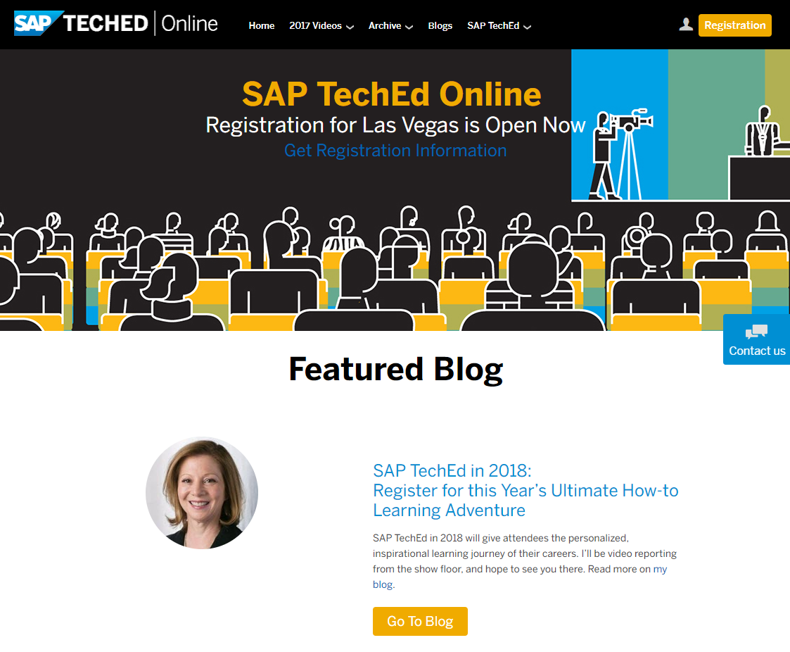
SAP TechEd online / SAP Community
Access replays of:
Keynotes
SAP TechEd live interviews
Selected lecture sessions
http://sapteched.com/online
Continue your SAP TechEd discussion after the event within SAP Community:
Read and reply to blog posts
Ask your questions
Join conversations
sap.com/community
See all SAP TechEd blog posts

Slide 21

Further information
Related SAP TechEd content journeys
DAT3 – Build Applications Using SAP HANA Native Development OPP2 – Build Cloud Native Apps with SAP Cloud Platform EXP3 – Level Up as a Developer
Related SAP TechEd sessions
DAT101 – What’s New in Native Development for SAP HANA DAT201 – Developing Applications Using Predictive and Machine Learning in SAP HANA DAT364 – Developing Smart Applications Using SAP HANA In-Database Machine Learning DAT815 – Machine Learning in SAP HANA OPP621 – Choose and Use the Right Programming Languages with SAP Cloud Platform
Public SAP Web sites
SAP Community: www.sap.com/community SAP products: www.sap.com/products
SAP training and certification opportunities
www.sap.com/education

Slide 22


Feedback
Thanks for attending this session.
Contact for further topic inquiries
Please complete your session evaluation for DAT368.
Andrew Lunde
Principal Solution Architect
andrew.lunde@sap.com

